Slide 1

Toward Triple Helix Implementation Teams for National Rollouts of GNU Health
Dr. Tom Kane
t.b.kane@stir.ac.uk
Senior Lecturer, Business Analytics
University of Stirling
Management School
Chair of EFMI Working Group on Free and Open Source Software

Slide 2
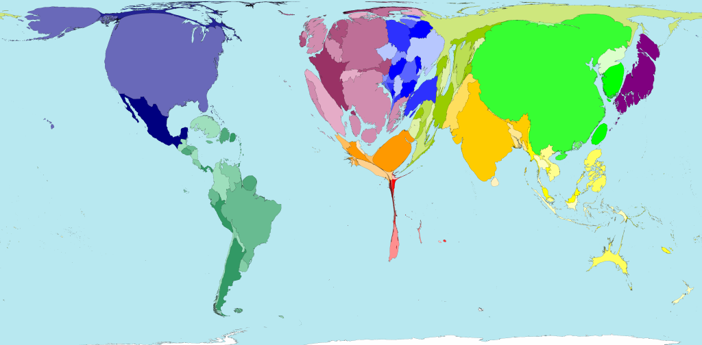
Problem Statement…
"Hundreds of thousands of African doctors need to be trained ... Nobody worries about it. There’s a rich part of the world that only cares about oil, diamonds, minerals, forests, gas, cheap labour ..." Fidel Castro, 2001
http://www.worldmapper.org/display.php?selected=219

Slide 3
Free/OS Software in Healthcare Could Help Reduce Costs of a Health Service…

Slide 4
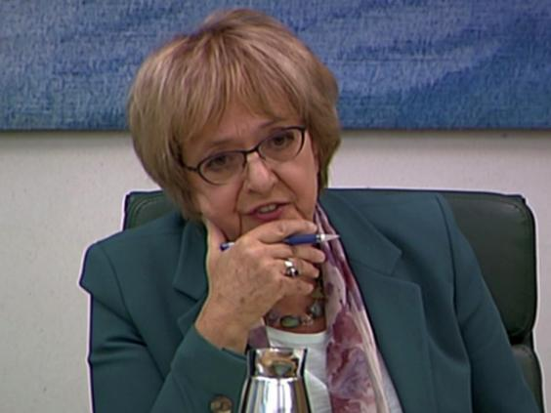
Biggest IT Failure Ever – Closed down in 2011
Lorenzo, to be produced by Computer Sciences Corporation, which was supposed to store data for 220 trusts in the north, eastern England and the Midlands at a cost of £3.1bn. The final contract for that project alone was £2.2bn and covered only 22 trusts.
Public Accounts Committee called CSC a “rotten company” and said the Lorenzo system was “hopeless”.

Slide 5
Free/Libre
The freedom to run the software as you wish, for any purpose.
The freedom to study how the software works, and change it so it does your computing as you wish. (Access to the source code is a precondition for this).
The freedom to redistribute copies so you can help your neighbour.
The freedom to distribute copies of your modified versions to others. By doing this you can give the whole community a chance to benefit from your changes. Access to the source code is a precondition for this.
Free/Libre is a type of Software, those with expertise in its development and use are experts. Very few experts work for nothing. The question – how to respect developers and users of such systems?

Slide 6
My Interest
How to overcome business issues of using F/L software
How to see GNU Solidario and GNU Health thrive in a successful implementation space
Business Models for different new scenarios and new stakeholder pictures
Key areas of research / business activity
Others…
Business Models for the sustainability of Free and Open Source Software Projects

Slide 7
Free Software in Healthcare Could Help Reduce Costs…
Q: And what about the expertise to develop it, run it, adapt it?

Slide 8
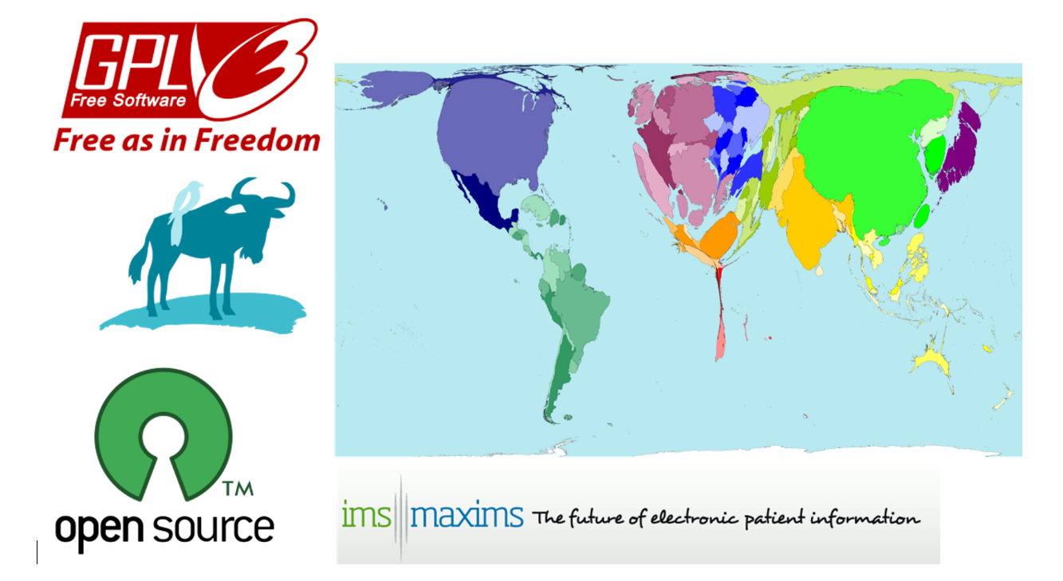
FLOSS
Industrial activity that needs investments, reward and sustainability…
And what about Co-ops?

Slide 9
The Triple Helix Approach
The triple helix model of innovation, as theorized by Etzkowitz and Leydesdorff, is based on the interactions between the three following elements and their associated ‘initial role’:[6]
universities engaging in basic research,
industries producing commercial goods and
governments that are regulating markets.[2]
As interactions increase within this framework, hybrid institutions evolve.

Slide 10
Government Issues
Internal Logics/ Drivers
External Pressures
Societal Scrutiny
The Professional Hierarchy
Service Users
Service Operators
Accountability
Policy
Financial Management
Standards
Integrity

Slide 11
Industry Issues
Internal Logics / Drivers
External Pressures
Financial Sustainability
Societal Scrutiny
The Professional Hierarchy:
Tool Operators
Product Users
Business Processes
Access to Markets
Investment
Buy-Make-Sell
Profitability
Business Ethics
Integrity

Slide 12
Academic Issues
Internal Logics / Drivers
External Pressures
Knowledge Imperative
Academic Credibility
Societal Relevance
Research Hunger
Knowledge Transfer
Research
Impact
Societal Relevance
Dialectics

Slide 13
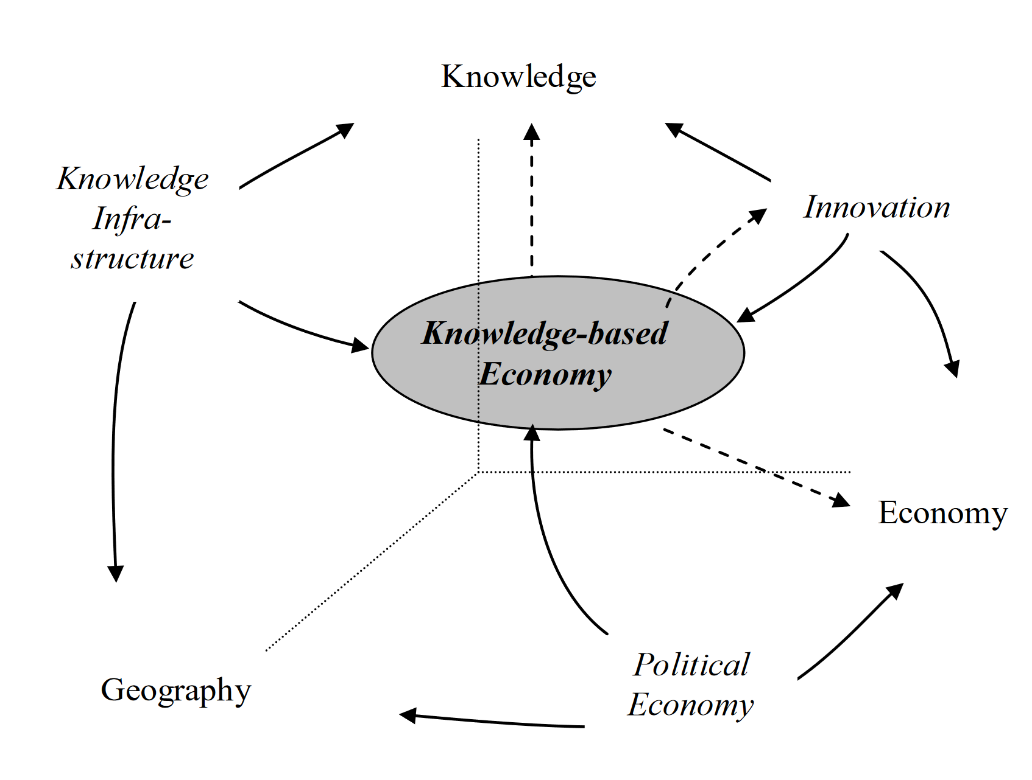
Flows of Contribution

Slide 14
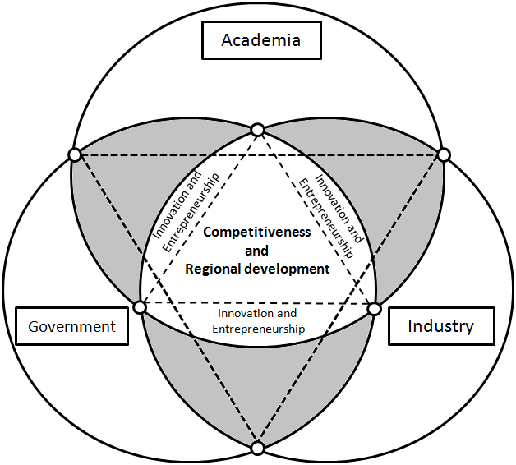
Triple Helix in General
Farinha, Luís. (2012). TRIANGULATION OF THE TRIPLE HELIX: A CONCEPTUAL FRAMEWORK. 10.13140/2.1.4161.1202.

Slide 15
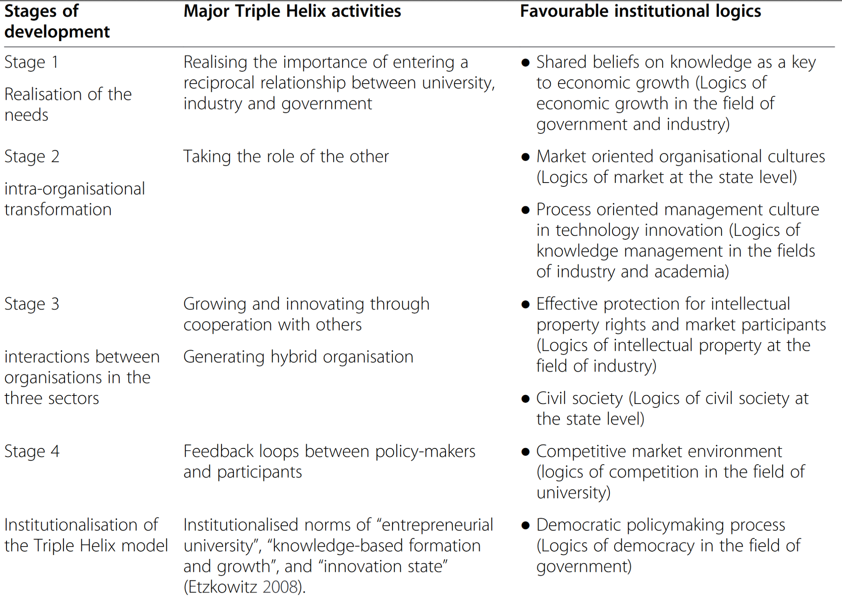
Triple Helix Partnering over Time
Cai Y (2013) Enhancing context sensitivity of the Triple Helix model: An institutional logics perspective. The Triple HelixXI International Conference, London

Slide 16
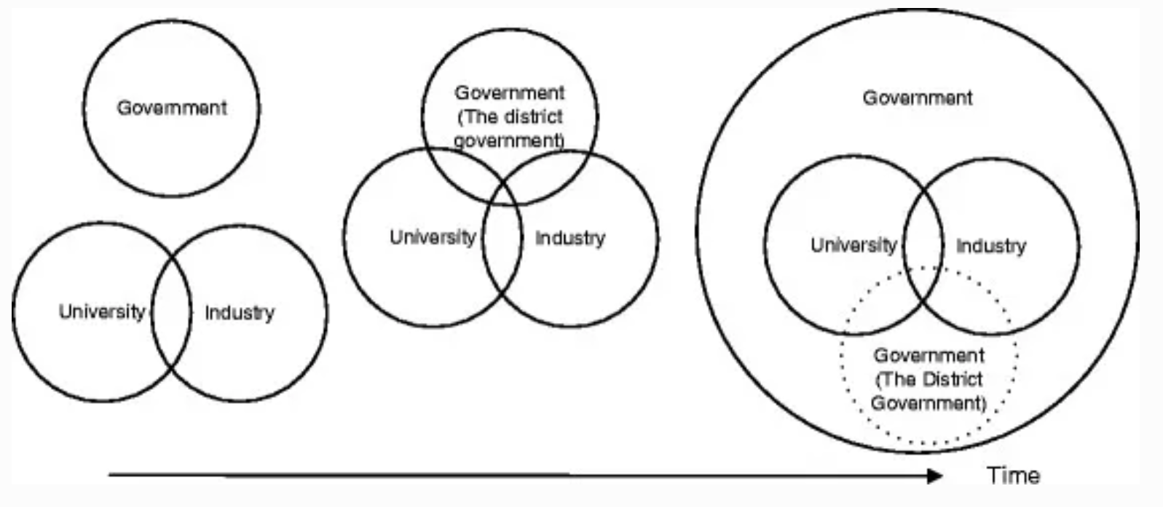
Aiming for a Delayed Government-led Model via Triple Helix Partnerships
Cai Y, Liu C: The roles of universities in fostering knowledge-intensive clusters in Chinese regional innovation systems. 2014, Science and , Public Policy

Slide 17
An Application to GCRF
The Idea: To work with Groups from Government, Industry and Academia in African Countries to Explore National and International Strategy

Slide 18
UK (March)
Ghana (June)
South Africa
Republic of Congo (Aug)
Kenya (Sep)
Run Structured workshops to cross-connect logics and establish hybrid understandings
Develop National and International Strategy

Slide 19
Governments – Ministry of Health of Kenya; Ministry of Health, Ghana, M.
Moi Teaching and Referral Hospital, Kenya.
The Universities of Moi (Kenya), Kwame Nkrumah University of Science and Technology (KNUST, Ghana) and South Africa (South Africa).
Industry and Non-Governmental Organisations – GNU Solidario, Future Worlds Center, Nelson Mandela Childrens Hospital, Axxite, Blue Rose, Nane, and Businesses involved in the design and maintenance of digital health systems including Data Lock in Kenya.
Toward Triple Helix Implementation Teams for National Rollouts of GNU Health

Slide 20
Objectives
National strategy appropriate to those using GH within each country;
effective (i.e. enabling improvement in health outcomes by supporting government policy and decision making clinically and managerially and by individual citizens, local communities and by other stakeholders, including international agencies);
resilient (i.e. provides acceptable service in the face of challenges, is adaptable to changes in software, hardware and service demands) and
sustainable (i.e. financial and non-financial resources flow continually to implement, maintain and improve systems).

Slide 21



Industry
University
Government
Countries: Kenya, Ghana, Republic of Congo, South Africa

Slide 22
Establishment of conditions of national policy suited to safe governmental support and participation in THENHIA implementations
Establishment of appropriate entrepreneurial grounds for industrial participation in THENHIA implementations
Establishment of suitable research tasks for participating academic institutions in THENHIA support and implementations
Establishment of National Triple Helix Teams for each participating country
Establishment of portal for international partnerships across the African continent.
Triple Helix Networks for Health Informatics in Africa (THENHIA)

Slide 23
Aims
Workshops
Implementations
To establish a working method for focusing on the professional services that are required, the costs of these services, and the benefits to the society of providing them
To establish contractual requirements and instruments of installation, maintenance, consultancy and development for the activities surrounding the Software.

Slide 24
Anyone Interested in Contributing Expertise or Experience
Any Thoughts?
Please Contact
To Help shape questionms for workshops
To help shape societal values that government policy can address
To help shape research projects
t.b.kane@stir.ac.uk
Thank you!

